Slide 1
Introduction to OPAMP
III Semister

Slide 2
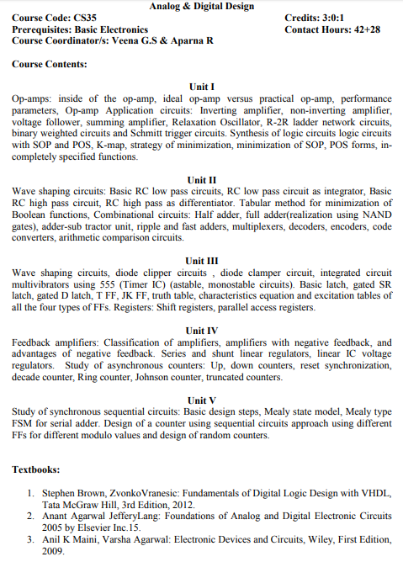
Introduction to OPAMP(Syllabus)
III Semister

Slide 3
Introduction to OPAMP
Operational Amplifier: An operational Amplifier also known as OPAMP is a High-gain differential amplifier capable of amplifying signals right from down to DC.
The capability of the opamp to amplify signals down to DC lies in the use of direct coupling mechanism in the internal architecture of the device. That is why it is also called a direct-coupled or DC amplifier

Slide 4
Introduction to OPAMP
The (+ve) input called the non-inverting input gives non-inverted amplified signal at the output.
The o/p is in phase with the input signal
The (-ve) input gives a inverted and amplified signal at the output.i.e, the o/p is out of phase from input by 180degree

Slide 5
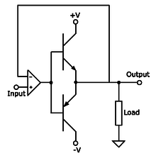
Introduction to OPAMPBlock Schematic arrangement of typical OPAMP
Class B Push Pull amplifier:
The output power that can be achieved is higher than the continuous dissipation rating of either transistor or tube used alone and increases the power available for a given supply voltage

Slide 6
Introduction to OPAMP-Block Schematic arrangement of typical OPAMP
Inside of a differential OPAMP
The differential amplifier organization is also called long tail pair as the two transistor share a common emitter resistor RE.
The collector o/p of Q1 becomes –ve of (inverting terminal) and the collector o/p of Q2 becomes +ve(Non-Inverting terminal of the OPAMP).
o/p obviously is in phase with non inverting terminal and out of phase by 180 from the inverting terminal of the opamp.
If V1 and V2 are the two inputs fed at inverting and non inverting terminal of the opamp then the o/p is given by V0=Ad(V2-V1)
Where Ad is the gain of

Slide 7
Introduction to OPAMP- Thevenin’s equivalent model of a generalized amplifier
Here The Difference voltage V_{d} between V_{NI} and V_{I} (i.e.,Non inverting and inverting input voltages) is fed across the input resistor Ri .
This results in an ouput which is equal to A_{d}V_{d which} reaches output through an output resistor R0
The assumptions made here is
Input resistance R_{I} is infinity
Output resistance R₀=0 and
The differential gain A_{d} is infinite

Slide 8
Introduction to OPAMP- Thevenin’s equivalent model of a generalized amplifier

Slide 9
Introduction to OPAMP-Performance parameter
The Performance parameters

Slide 10
Introduction to OPAMP-Performance parameter
The Performance parameters
Bandwidth:
Bandwidth of an OPAMP tells us the range of frequencies where the OPAMP can amplify for a given amplifier gain.
It is normally expressed as unity gain cross over frequency also called gain-bandwidth product
It is typically 1MHz for OPAMP µA 741

Slide 11
Introduction to OPAMP-Performance parameter
The Performance parameters
Slew Rate:It is the measure of how well the output responds to rapid change in input waveform.
OPAMP IC µA 741 has a slew rate of 0.5V/µs.
If it is a sinusoidal waveform then
Bandwidth(Highest frequency fmax=slewrate/(П* Vp-t-p)

Slide 12
Introduction to OPAMP-Performance parameter
The Performance parameters
Open Loop gain:It is ratio ofsingle –ended output to the differential input.
The Ratio of the open-loop gain to closed loop gain is called the loop gain.
The Diagram shows the open loop gain vs the frequency.
As a rule of thumb The gain error at a given frequency is given by the ratio of closed loop gain to open loop gain.
Hence larger the value of the openloop gain smaller will be the gain error

Slide 13
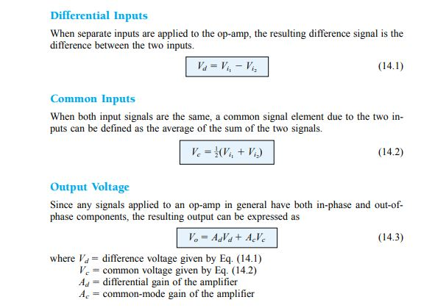
Introduction to OPAMP-Performance parameter
The Performance parameters
Common Mode Rejection Ratio(CMRR): It is a measure of the ability of the opamp to suppress a common mode signal.
It is the ratio of desired differential gain(Ad) over the undesired common mode gain(Ac).
This ratio of CMRR is expressed in decibel i.e., CMRR =20log(Ad/Ac)

Slide 14
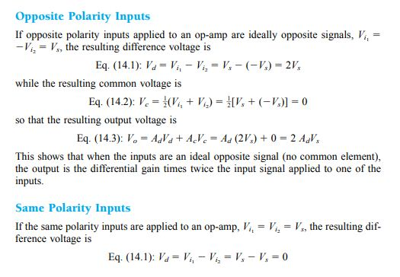
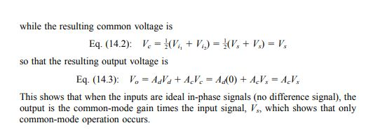
Introduction to OPAMP-Performance parameter
The Performance parameters
Common Mode Rejection Ratio(CMRR): It is a measure of the ability of the opamp to suppress a common mode signal.
It is the ratio of desired differential gain(Ad) over the undesired common mode gain(Ac).
This ratio of CMRR is expressed in decibel i.e., CMRR =20log(Ad/Ac)

Slide 15
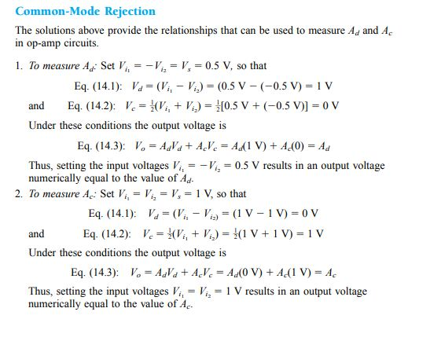
Introduction to OPAMP-Performance parameter
The Performance parameters
Common Mode Rejection Ratio(CMRR): It is a measure of the ability of the opamp to suppress a common mode signal.
It is the ratio of desired differential gain(Ad) over the undesired common mode gain(Ac).
This ratio of CMRR is expressed in decibel i.e., CMRR =20log(Ad/Ac)

Slide 16
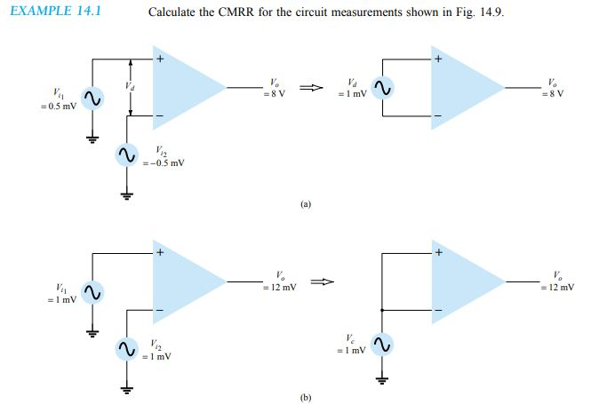
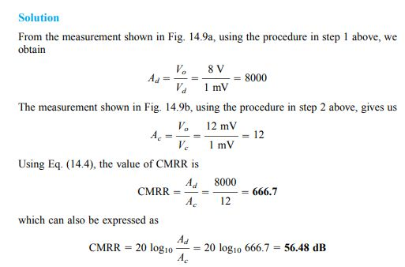
Introduction to OPAMP-Performance parameter

Slide 17
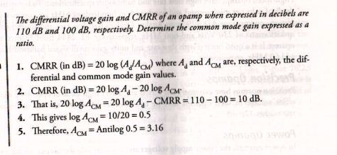
Introduction to OPAMP-Performance parameter(CMRR )

Slide 18
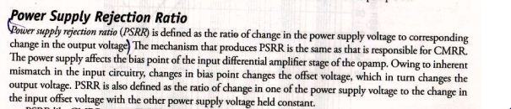
Introduction to OPAMP-Performance parameter(PSRR)

Slide 19
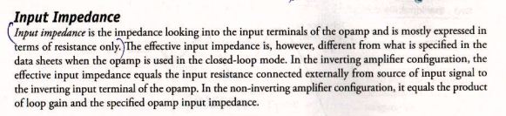
Introduction to OPAMP-Performance parameter

Slide 20
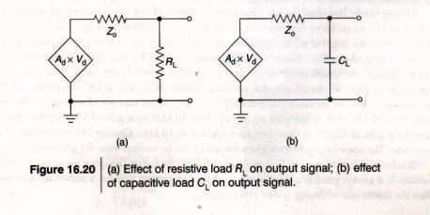
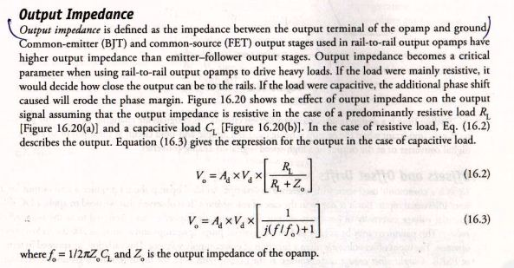
Introduction to OPAMP-Performance parameter

Slide 21
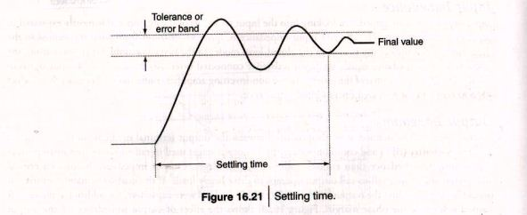
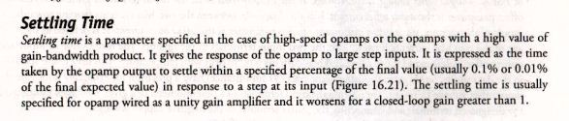
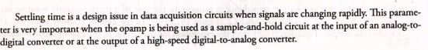
Introduction to OPAMP-Performance parameter

Slide 22
Introduction to OPAMP-Performance parameter-Off Sets and Drifts
A) Input Bias Current
B) Input Offset Current
C)Input Offset Current Drift
D) Input Offset Voltage
E)Input Offset Voltage Drift
F)Output Offset Voltage

Slide 23
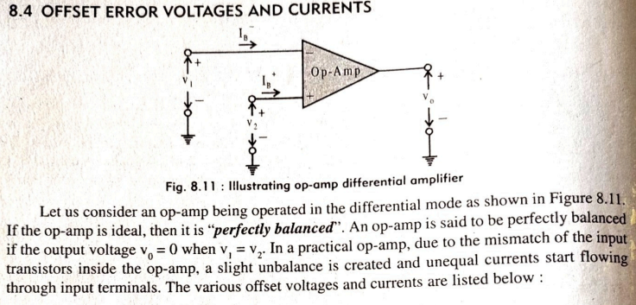
Introduction to OPAMP-Performance parameter-Off Sets and Drifts

Slide 24
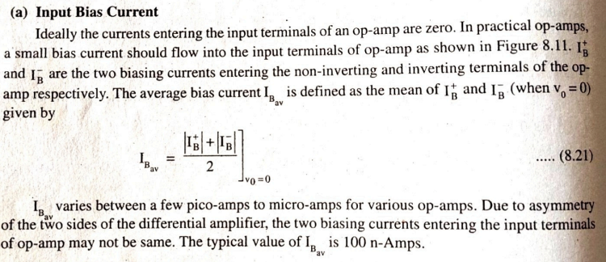
Introduction to OPAMP-Performance parameter-Off Sets and Drifts

Slide 25
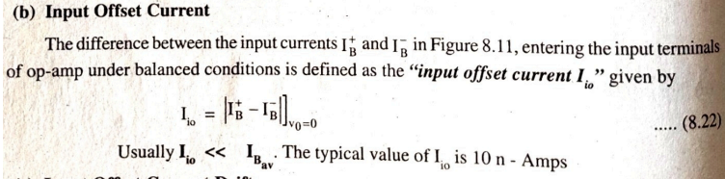
Introduction to OPAMP-Performance parameter-Off Sets and Drifts

Slide 26
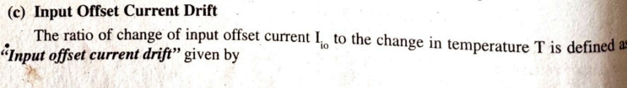
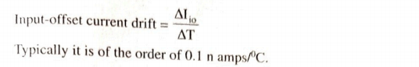
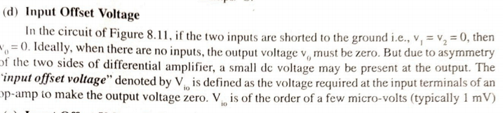
Introduction to OPAMP-Performance parameter-Off Sets and Drifts

Slide 27
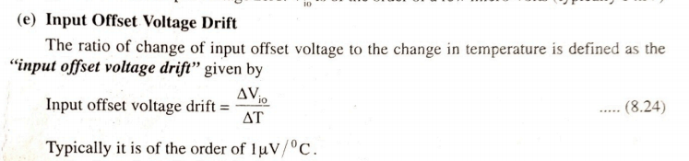
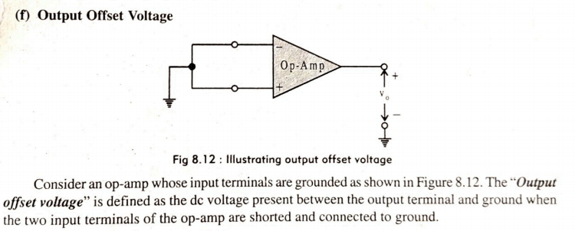
Introduction to OPAMP-Performance parameter-Off Sets and Drifts

Slide 28
OPAMP- APPLICATION
Inverting Amplifiers
Non-Inverting Amplifiers
Inverting Summer
Non-Inverting Summer
Difference Amplifier

Slide 29
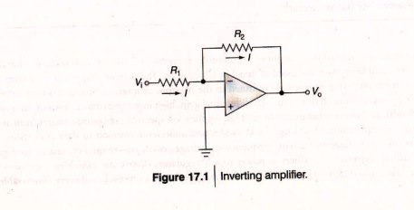
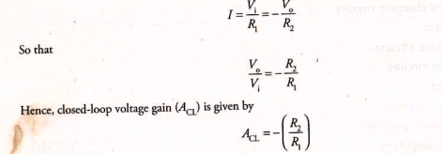
OPAMP- APPLICATION
Inverting Amplifiers(DC Amplifier)

Slide 30
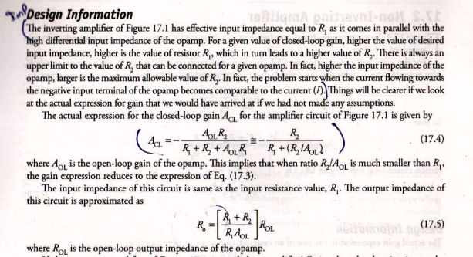
OPAMP- APPLICATION
Inverting Amplifiers(DC Amplifier)

Slide 31
OPAMP- APPLICATION
Inverting Amplifiers(DC Amplifier)

Slide 32
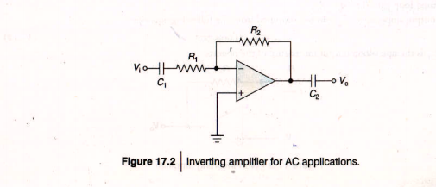
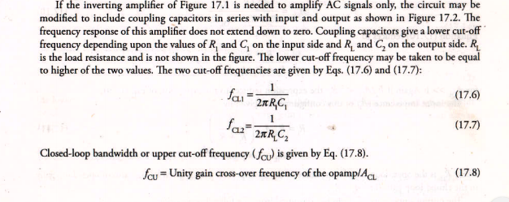
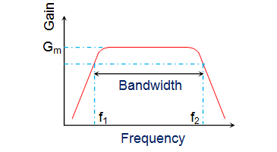
OPAMP- APPLICATION
Inverting Amplifiers(AC Amplifier)

Slide 33
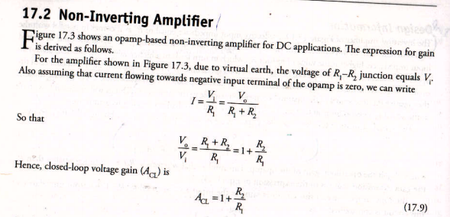
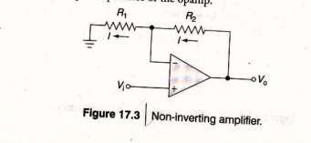
OPAMP- APPLICATION
Non-Inverting Amplifiers(DC Amplifier)

Slide 34
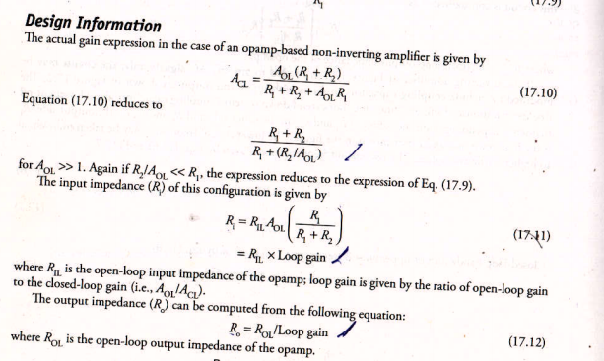
OPAMP- APPLICATION
Non-Inverting Amplifiers(DC Amplifier)

Slide 35
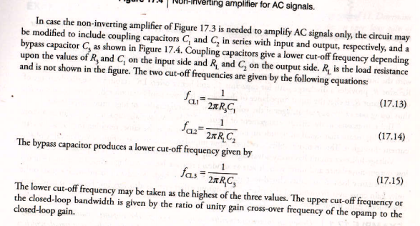
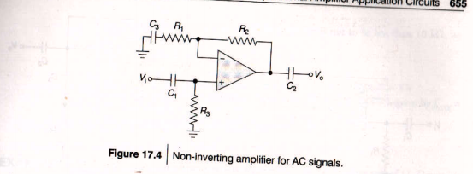
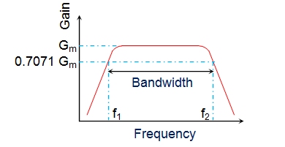
OPAMP- APPLICATION
Non-Inverting Amplifiers(AC Amplifier)

Slide 36
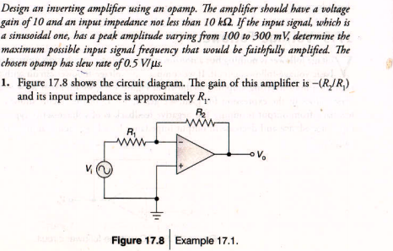
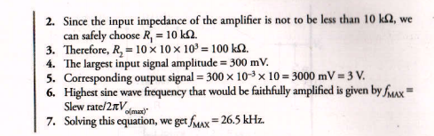
OPAMP- APPLICATION
Problems

Slide 37
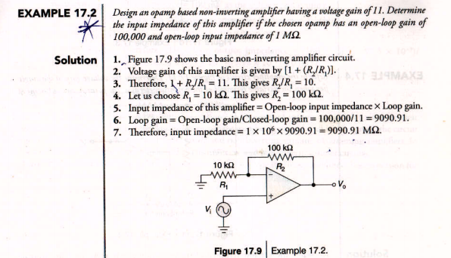
OPAMP- APPLICATION
Problems and Solutions

Slide 38
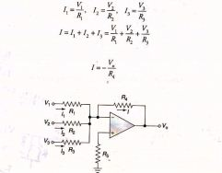
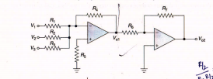
OPAMP- Inverting Summer Amplifier
Here V0=-(V1+V2+V3) if R1=R2=R3=R4=R
If V0 has to be positive Then Use one more inverting amplifier to invert it.
Limitation The summation of total voltage cannot be more than the saturation voltage.

Slide 39
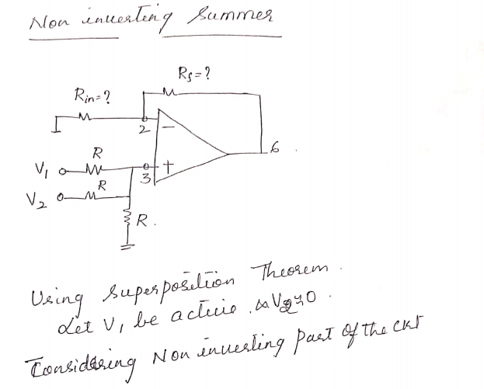
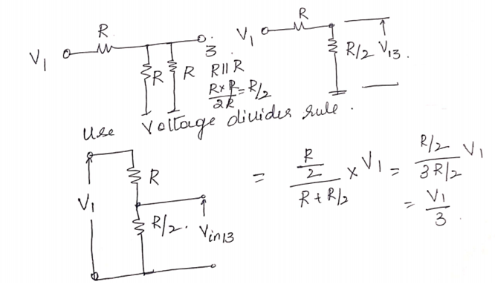
OPAMP- Non Inverting Summer Amplifier

Slide 40
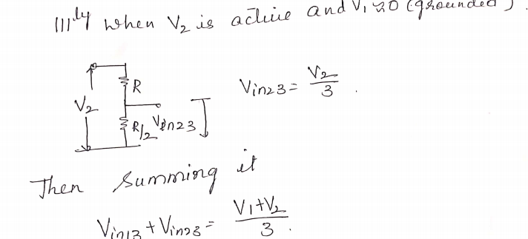
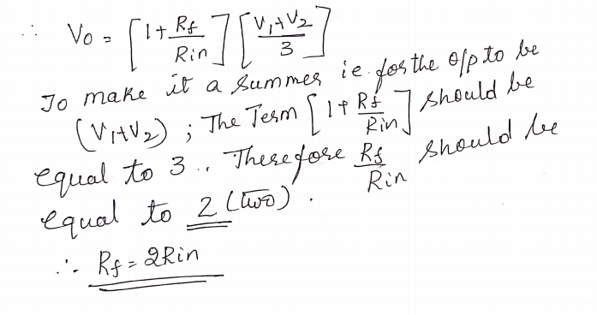
OPAMP- Non Inverting Summer Amplifier

Slide 41
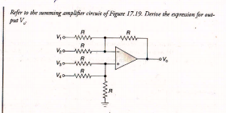
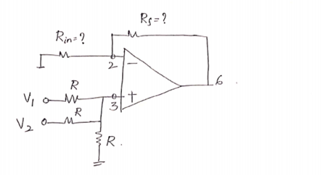
OPAMP-Difference Amplifier and Non Inverting Averager Circuit
Design a Two I/P Non Inverting Averager Circuit
??
2-input average..if the gain ration of the above circuit is maintained at 3/2 then it works as average with 2-input.
Hence (1+RF/R)=3/2
Rf/R=1/2
Hence Rf=0.5 *R
Hence If R=1KΩ,
Then Rf=0.5KΩ

Slide 42
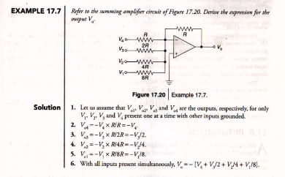
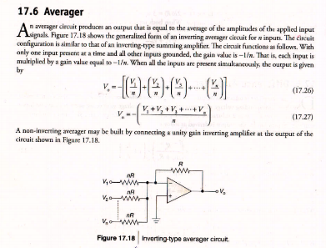
OPAMP-D/A Converter and Inverting Averager Circuit

Slide 43
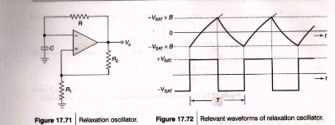

OPAMP-Relaxation Oscillator

Slide 44



OPAMP- Digital to Analog Converter(D/A Converters
if b0 is closed
It will be connected directly to the +5V.
Thus, voltage across R = 5V
Current through R = 5V/10kohm = 0.5mA
1. Binary weighted D/ A Converter
2. R/ 2R Ladder D/A Converter
1. Binary weighted D/ A Converter

Slide 45
OPAMP- Digital to Analog Converter(D/A Converters
if b0 is closed
It will be connected directly to the +5V.
Thus, voltage across R = 5V
Current through R = 5V/10kohm = 0.5mA
1. Binary weighted D/ A Converter
2. R/ 2R Ladder D/A Converter
1. Binary weighted D/ A Converter
Advantages: • It is Simple in Construction. • It provides fast conversion. Disadvantages: • This type requires large range of resistors with necessary high precision for low resistors. • Can be expensive. Hence resolution is limited to 8-bit size.

Slide 46




OPAMP- Digital to Analog Converter(D/A Converters
R/ 2R Ladder D/A Converter

Slide 47

OPAMP- Digital to Analog Converter(D/A Converters
R/ 2R Ladder D/A Converter

Slide 48
OPAMP- Digital to Analog Converter(D/A Converters
R/ 2R Ladder D/A Converter
Advantages: • Only two resistor values are used in R-2R ladder type. • It does not need as precision resistors as Binary weighted DACs. • It is cheap and easy to manufacture. Disadvantages: • It has slower conversion rate.

Slide 49
OPAMP- Digital to Analog Converter(D/A Converters
R/ 2R Ladder D/A Converter
Design a 6 bit R-2R ladder Network if Vlow=1V and Vhigh =6V, Given the following input Write the circuitry of 6-bit R/2R Ladder N/W
V0= - (b5/2+b4/4+b3/8+b2/16+b1/32+b0/64)
If the Input is with Vhigh=6V and Vlow=1V, find the output for the following input
i/p=010101
V0=-(1/2+6/4+1/8+6/16+1/32+6/64)
= -(0.5+1.5+0.125+.375+0.03125+0.09375)
= - 2.6249
i/p=101010
V0= - (6/2+1/4+6/8+1/16+6/32+1/64)
= - (3+0.25+0.75+0.0625+0.1875+0.015625)
=-4.26525

Slide 50
OPAMP- Digital to Analog Converter(D/A Converters
R/ 2R Ladder D/A Converter
Design a 6 bit R-2R ladder Network if Vlow=1V and Vhigh =6V, Given the following input Write the circuitry of 6-bit R/2R Ladder N/W
V0= - (b5/2+b4/4+b3/8+b2/16+b1/32+b0/64)
If the Input is with Vhigh=6V and Vlow=1V, find the output for the following input
i/p=111111
V0 = - (6/2+6/4+6/8+6/16+6/32+6/64)
= - (3+1.5+0.75+.375+0.1875+0.09375)
-5.90625
iv)i/p=000001
V0=-(1/2+1/4+1/8+1/16+1/32+6/64)
= -(0.5+0.25+0.125+0.1875+0.03125+0.09375)
= -1.1875

Slide 51



WAVESHAPING

Slide 52



WAVESHAPING-Step Input and Pulse Input Response of a low pass filter

Slide 53


WAVESHAPING-Step Input and Pulse Input Response of a low pass filter

Slide 54


WAVESHAPING-Low Pass RC Circuit and Integrator

Slide 55



WAVESHAPING-Low Pass RC Circuit Problems

Slide 56



WAVESHAPING-Low Pass RC Circuit Problems

Slide 57


WAVESHAPING-Low Pass RC Circuit Problems

Slide 58

WAVESHAPING-Low Pass RC Circuit Problems

Slide 59

WAVESHAPING-Low Pass RC Circuit Problems

Slide 60


WAVESHAPING-High Pass RC Circuit

Slide 61

WAVESHAPING-High Pass RC Circuit(Response for a pulse input)

Slide 62

WAVESHAPING-High Pass RC Circuit as Differentiator

Slide 63


WAVESHAPING-High Pass RC Circuit

Slide 64


WAVESHAPING-High Pass RC Circuit

Slide 65


Clipper Circuits- Series Clipper and Parallel Clippers

Slide 66


Clipper Circuits- Series Clipper and Parallel Clippers

Slide 67

Clipper Circuits- Series Clipper and Parallel Clippers- considering Diode forward bias voltage

Slide 68


Clipper Circuits-

Slide 69

Clipper Circuits-

Slide 70

Clipper Circuits-

Slide 71

Clipper Circuits-

Slide 72

Clampers
CLAMPERS The clamping network is one that will “clamp” a signal to a different dc level.
The network must have a capacitor, a diode, and a resistive element, but it can also employ an independent dc supply to introduce an additional shift.
The magnitude of R and C must be chosen such that the time constant RC is large enough to ensure that the voltage across the capacitor does not discharge significantly during the interval the diode is nonconducting.

Slide 73
Clampers
In general, the following steps may be helpful when analyzing clamping networks:
1. Start the analysis of clamping networks by considering that part of the input signal that will forward bias the diode.
2. During the period that the diode is in the “on” state, assume that the capacitor will charge up instantaneously to a voltage level determined by the network.
3. Assume that during the period when the diode is in the “off” state the capacitor will hold on to its established voltage level.
4. Throughout the analysis maintain a continual awareness of the location and reference polarity for vo to ensure that the proper levels for vo are obtained.
5. Keep in mind the general rule that the total swing of the total output must match the swing of the input signal.

Slide 74


Clampers

Slide 75
Clampers
Diode is conducting in –ve half so start with the negative half
-20 V = -VC +5 V
VC= 25 V
Then in the positive half
10 V= - 25 V +v 0
V0=35V

Slide 76

Clampers(Negative Clamper)

Slide 77

Clampers(Positive Clamper)(Direction of the Diode is wrongly given in the text book)

Slide 78

Clampers

Slide 79


Clampers
The diode is conducting in –ve direction ,evaluating the –ve half setting the polarity of capacitor to –ve
-5v=-Vc-2v
Vc=5-2=3v.
In +ve half the polarity of the capacitor remains same ,i.e., -ve
+5v=-3v+V0
V0=5+3=8V
b)The diode is conducting in+ve half direction ,hence the polarity of the capacitor is +ve.
+5v=Vc+2V
Vc=5-2=3V
In –ve half cycle
-5V=3V+V0
V0=-8V
c) The Diode is conducting in –veHalf , so the polarity of the capacitor is –ve
-5V=-Vc+2V
Vc=-5-2=-7Vs
In positive half
+5V=-7V+V0
V0=%+7V=12V

Slide 80

MULTIVIBRATOR

Slide 81


ASTABLE MULTIVIBRATOR

Slide 82

ASTABLE MULTIVIBRATOR

Slide 83

ASTABLE MULTIVIBRATOR
Tc=0.69RAC
Td=0.69RBC
Ttotal=Tc+Td
Duty Cycle=(Tc/Ttotal)*100 %
F=1/Ttotal

Slide 84


ASTABLE MULTIVIBRATOR

Slide 85



ASTABLE MULTIVIBRATOR

Slide 86


ASTABLE MULTIVIBRATOR

Slide 87


ASTABLE MULTIVIBRATOR

Slide 88

ASTABLE MULTIVIBRATOR

Slide 89


Monostable Multivibrator

Slide 90


Monostable Multivibrator

Slide 91


Monostable Multivibrator

Slide 92

Voltage Regulators

Slide 93
Voltage Regulators

Slide 94


Voltage Regulators

Slide 95

Voltage Regulators

Slide 96



Voltage Regulators

Slide 97

Emitter –Follower Regulator Using Darlington Transistor Pair

Slide 98



Series –Pass Linear Regulator-
Vref=V0*R2/(R2+R1) Therefore, V0=Vref*(R2+R1)/R2

Slide 99


Shunt Regulators

Slide 100

Shunt Regulators

Slide 101

Shunt Regulators

Slide 102

Shunt Regulators-Darlington Pair Transistors

Slide 103
Shunt Regulators-Darlington Pair Transistors

Slide 104




Slide 105




Slide 106




Slide 107

Linear IC Voltage Regulators

Slide 108


Linear IC Voltage Regulators

Slide 109


Linear IC Voltage Regulators

Slide 110

Linear IC Voltage Regulators

Slide 111

Linear IC Voltage Regulators

Slide 112


Linear IC Voltage Regulators

